Slide 1
The SS Willpower

Slide 2
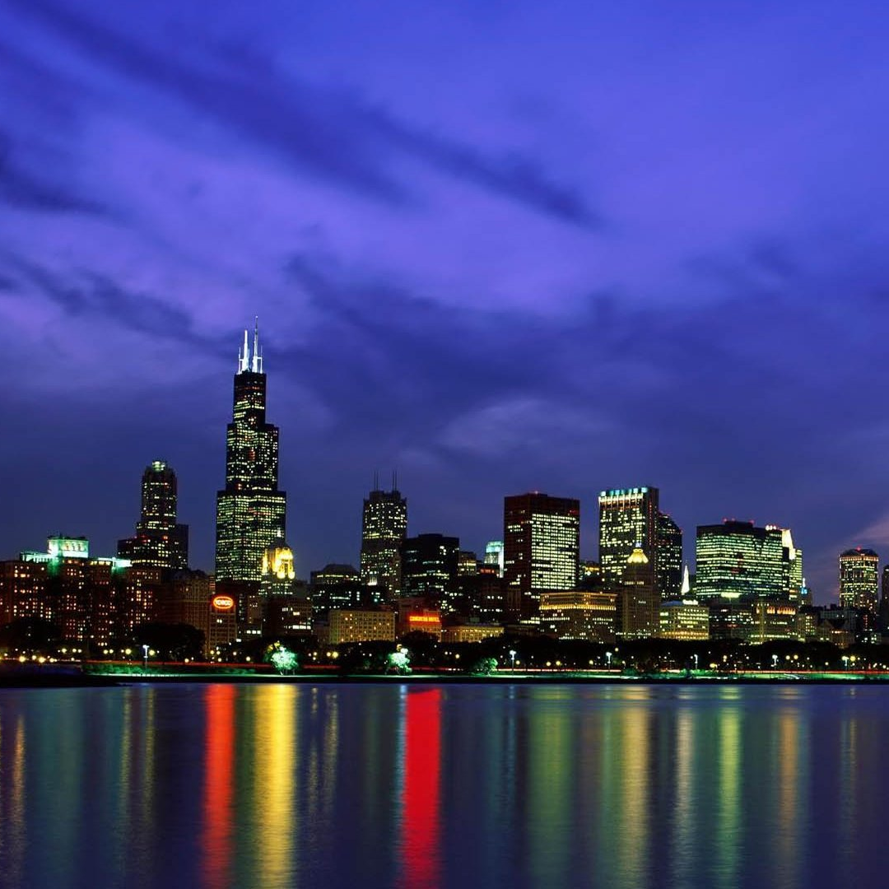
Importance of the Great Lakes
21% of the world’s freshwater
7% USA agriculture
25% Canadian agriculture
25% Canadian drinking water
10% USA drinking water
Notes:
Have you ever visited a beach in the great lakes? I have lived all my life in the suburbs of Chicago, and ever since I was little, my family would drive up to Northern Michigan over memorial day and stay right along the coast of Lake Michigan.
The Great Lakes hold 21% of the world’s freshwater
The water from the lakes help supply the entirety of U.S

Slide 3
THE PROBLEM
22 million pounds of plastic enter in the Lakes every single year
Notes:
But recently, the lakes that i’ve enjoyed ever since i was little have become more and more polluted.
This plastic can fill 100 olympic size swimming pools, and the issue is, that the majority of the plastic doesn’t originate from the shoreline beaches
This plastic breaks down into microplastic and has been found in our drinking water. So, at least 25% Canadian drinking water and 10% USA drinking water contains microplastics.
In addition to the effect on humans, the plastics in the lake has a major impact on wildlife. Wildlife is getting entangled in plastic rings and fishing lines, but the microplastics in the water
Bad for animal and plants in the water
Contaminated the water
Wastes large amounts of plastic
Costs a lot of time and money to clean up the plastic
Boat lowers the cost of and the time it takes to clean up

Slide 4
THE SOLUTION
The S.S Willpower

Slide 5

Boat 3D Model
Notes:
talk about how it works, we drop it in lake, it takes a preplanned route deeper into the lake, it scans for nearby plastic, it sends coordinates of the center location of a plastic zone for other boats to cleanup

Slide 6
Demo

Slide 7
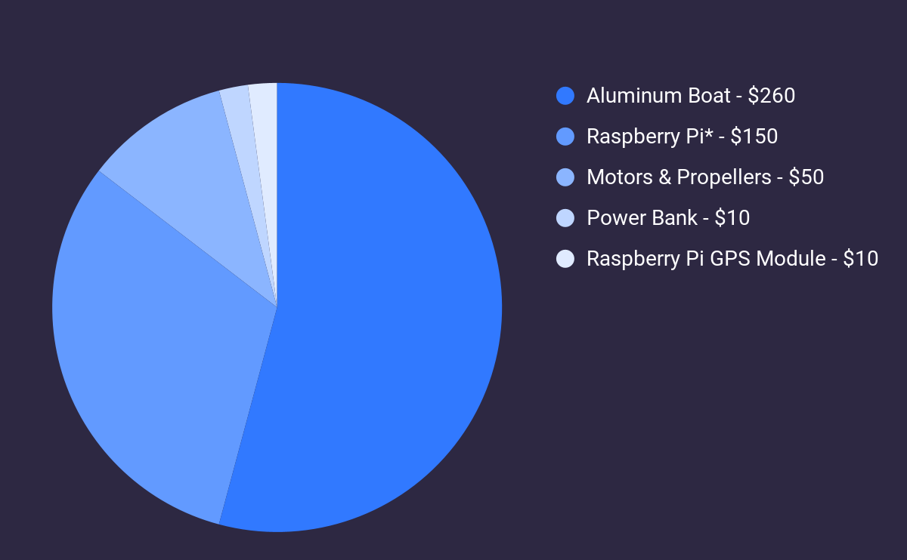
Cost of Implementation
Total - $480
* Raspberry Pi, Camera, BrainHAT, Camera Cable, SD Card Case, Camera Case, SD Card

Slide 8
Impact
Notes:
With this boat, we would be able to cut costs and the amount of time it would take to identify trash in the great lakes. Instead of needing larger boats with people, we would reduce the time it would take for people to go pick up the trash. This would have a major impact on on the drinking water for Americans and Canadians and for the wildlife species in the area. We would be able to expand this in other areas throughout the united states and abroad to find plastic in locations that may not be readily accessible for people.

Slide 9
Sources
Ahmad, Sidrah. "Pollution Levels in the Great Lakes." Waterlogic, Oct. 2018,
www.waterlogic.com/en-us/resources-blog/the-great-lakes/. Accessed 24 July
2021.
McCarty, Anna. "Chemical Pollution in the Great Lakes." Office of Response and
Restoration, NOAA, 9 Feb. 2017, response.restoration.noaa.gov/about/
media/chemical-pollution-great-lakes.html. Accessed 24 July 2021.
Bjorhus, Jennifer. "Great Lakes' Latest Pollution Threat: Microplastics."
Phys.org, 12 Aug. 2019, phys.org/news/
2019-08-great-lakes-latest-pollution-threat.html. Accessed 24 July 2021.
https://empoweringmichigan.com/michigan-great-lakes-protect-pollution/

